Slide 1

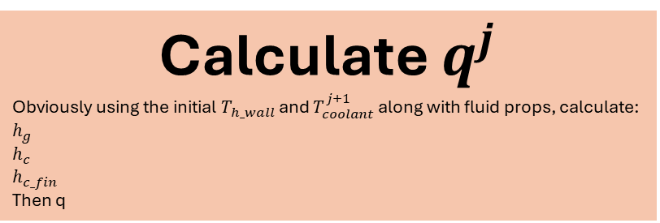
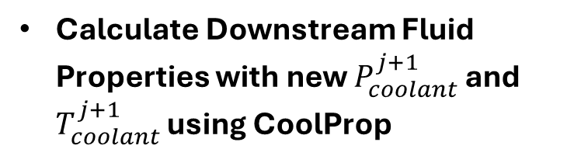

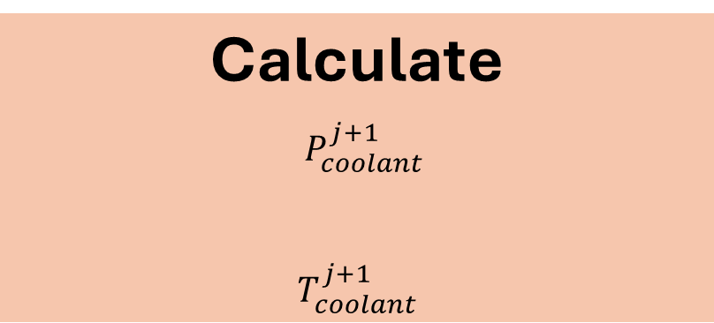
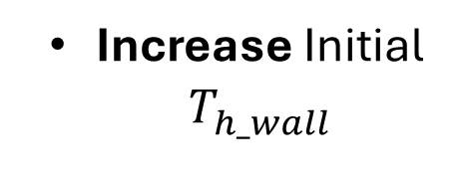



Set $T_{coolant}^{j+1}=T_{coolant}^{j}$
Guess Initial $T_{h_wall}^{ }$
On first run, $T_{coolant}^{j}$ will be initial coolant temperature entering the cooling channels. As we step through iterating in each cell, the future sections initial coolant temperature will be the one beforehand. As the calculations progress this temperature will obviously increase until the solution converges for that cell
Calculate $q^{j}$
Obviously using the initial $T_{h_wall}$ and $T_{coolant}^{j+1}$ along with fluid props, calculate:
$$h_{g}$$
$$h_{c}$$
$$h_{c_fin}$$
Then q
Increase Initial $T_{h_wall}^{ }$
Calculate $T_{h_wall}^{j+1}$
$$T_{h_wall}^{j+1}=T_{h_wal}^{j}− \frac{q^{j}}{h_{g}^{j}}$$
Temperatures
Converge?
No
Yes
Calculate
$P_{coolant}^{j+1}$
$$T_{coolant}^{j+1}$$
Update $ρ$ and $υ$ using CoolProp and new $H_{coolant}^{i+1}$ and $P_{coolant}^{i+1}$ values
Calculate Downstream Fluid Properties with new $P_{coolant}^{j+1}$ and $T_{coolant}^{j+1}$ using CoolProp
$ρ$ and $υ$ Converge?
No
Calculate
$H_{coolant}^{i+1}$
$P_{coolant}^{i+1}$
DONE
Yes

